Slide 1
Story Board
Hyrail Project

Slide 2
The opening scenes are located within cities. There is a low saturation and a darker toning. From the start, there is no voice and little text, just imagery and ambient sound of what is happening in the scene.

Slide 3
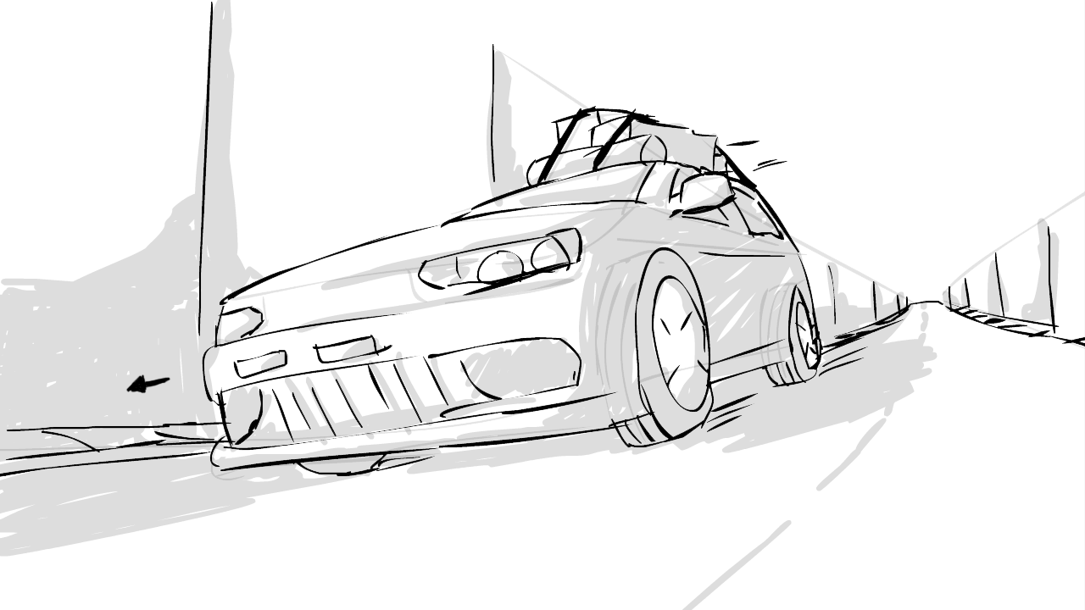
A car is driving down the New York city streets. It flies off screen to the left, past a still, low camera.

Slide 4
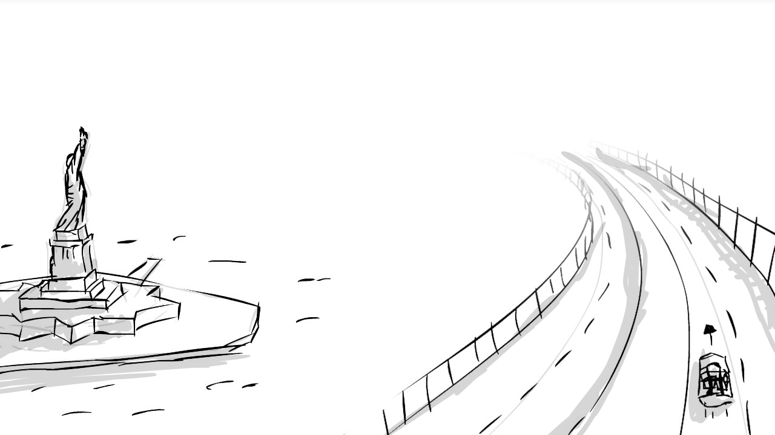
The camera quickly spins around to spot the car traveling down the Brooklyn Bridge. As the car travels away, the camera slowly flies upward.

Slide 5
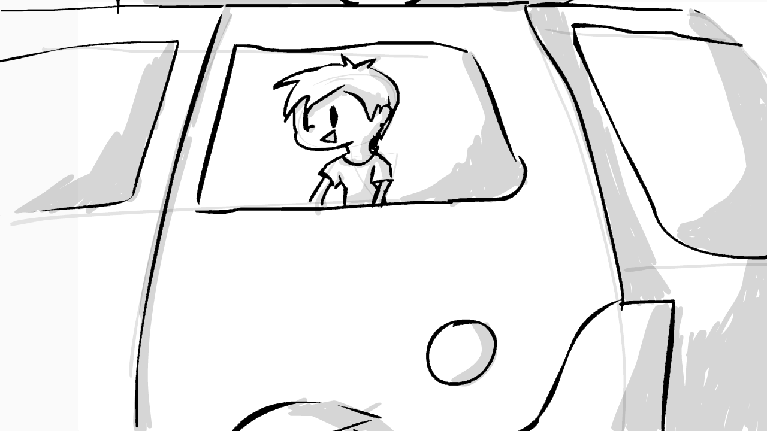
The scene then cuts to the side of the car to focus on a young boy…

Slide 6
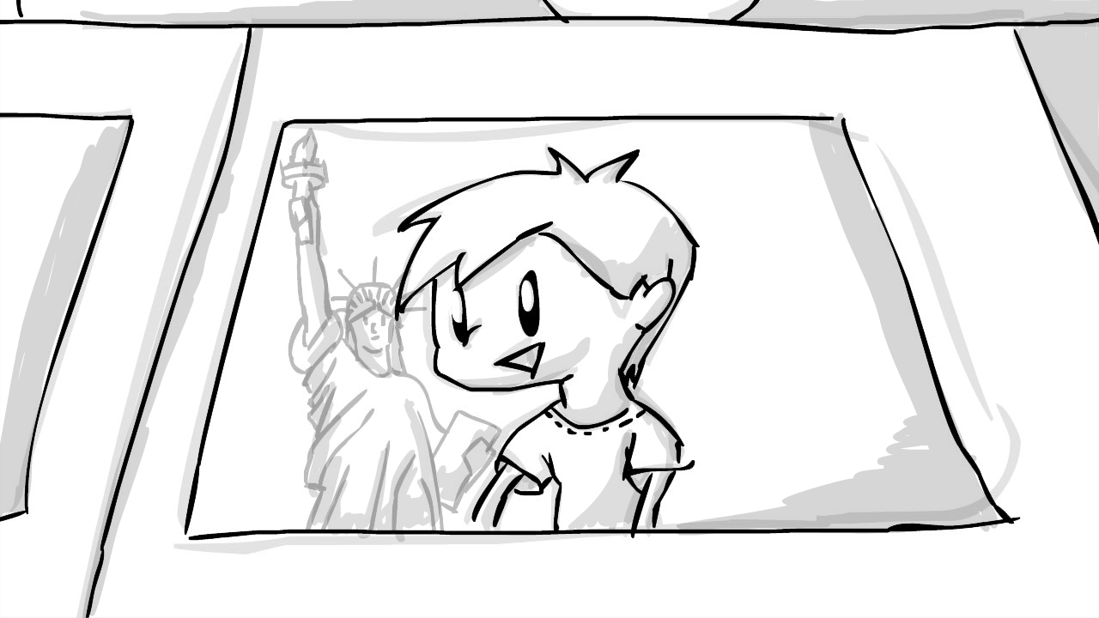
As the camera slowly zooms in closer to the child, a reflection of the statue of liberty becomes visible on the window.

Slide 7
Thus far, everything has seemed rather pleasant. A child traveling with his family and enjoying the view of the statue of liberty… But now, things begin to slowly change…The low saturation and dark tone remain, truly setting in the feeling of the following scenes. Text fade-ins appear with the voice, summing up the negative facts.

Slide 8
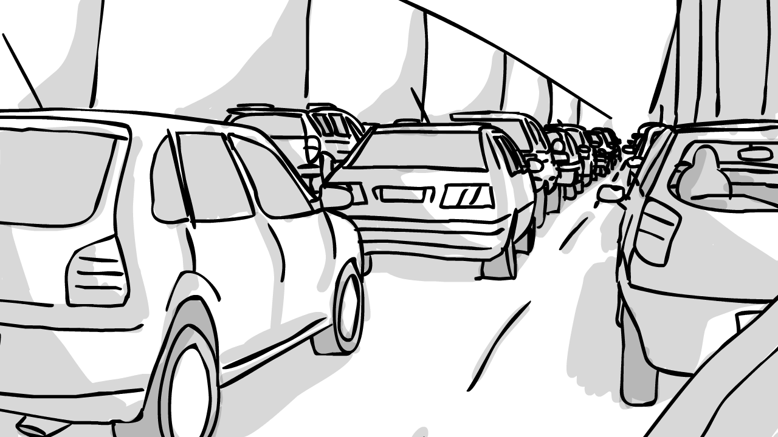
From the view of the child, the camera looks from the car window to glance towards the front of the car and spot a heavy traffic jam building up.

Slide 9
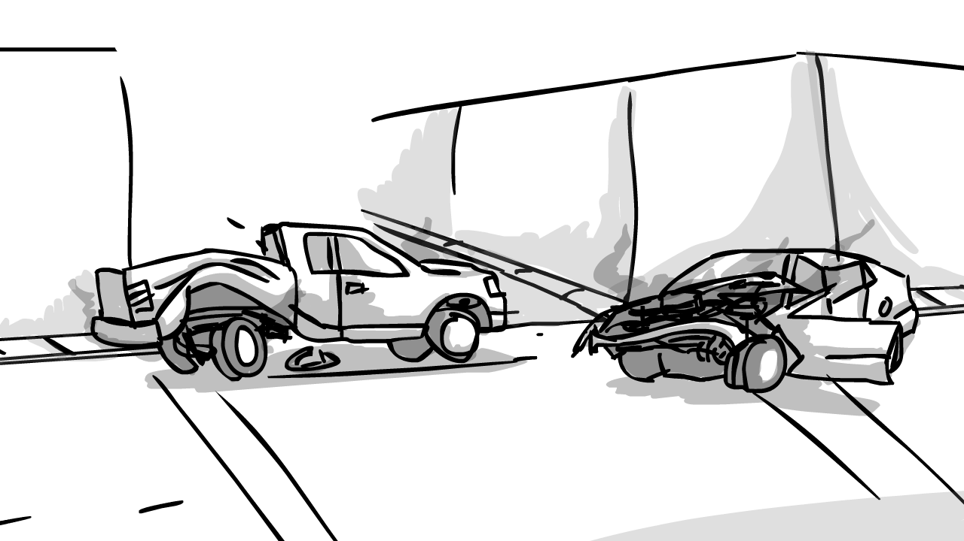
The camera fades to black with a short passing of time. As it fades back in, the camera pushes forth as if to lean against the car window. You begin slowly moving past a bad accident. A voice finally speaks, describing how accidents impact society.

Slide 10
The camera fades to black. As it fades back in, the car slowly moves along as traffic clears out. During this moment, you pass a gas station, worn down and stuffed with cars. As the camera looks up, you focus on the towering sign displaying a jacked-up price. A voice describes how gas impact society.

Slide 11
The camera fades to black. As it fades back in, the camera glances upward at a towering coal factory. As you drive along, the factory spits out thick, black smoke from it towers, darkening the sky. A voice describes how society effects the environment.

Slide 12
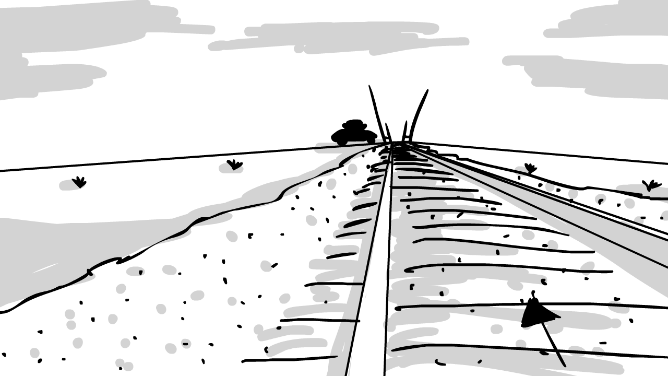
The camera fades to black. As it fades back in, the camera is placed low and close to a line of train tracks. Quickly, a train roars past.

Slide 13
The camera cuts back to the viewpoint of the child, watching as a train passes and the gates lift for the car to pass the tracks.

Slide 14
As the cars jumps over the rails, you begin to focus on a line of people moving towards one location. Men and women, young and old, individuals and families…

Slide 15
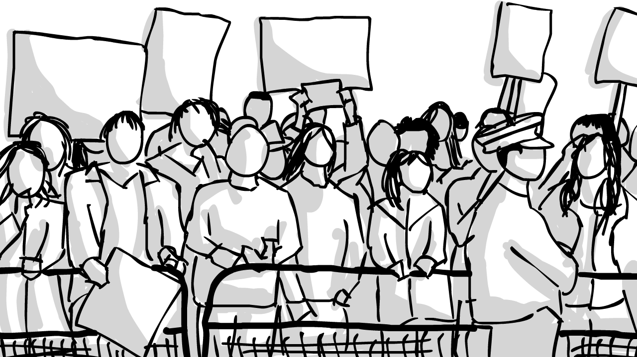
…as you follow the line of people up and the car moves forth, you pass a large group of people picketing for jobs to support themselves and their families. A voice describes the impact job loss has had on society.

Slide 16
The camera fades to black. (This is a longer pause as it is a major transitioning point). Up until now, everything has been negative. But now, things begin to shift as the Hyrail is introduced. The camera fades back in, the color returning to the screen for the following images. Though the tone has been rather dark thus far, things are about to become lighter. Text fade-ins now focus on summing up the positive facts.

Slide 17
It is a bright and sunny day, the car is now located outside the city, showcasing the vibrant colors of nature. The camera is placed high and in front of the car as it drives toward it and away from the city.

Slide 18
As the camera flips around to keep on the car, you notice that they are located on the highway, though traffic continues to remain heavy. But…the car does not remain on the highway like the others, instead you see the car pull off the highway and into the Hyrail station. A voice describes how the Hyrail will change society.

Slide 19
The camera then cuts to be placed within the boarding station ahead of the car. The car then enters the scene and slowly pulls onto the vehicle transport. A quick shot shows the wheels settling into the transport and locking into place as the door closes and they pull away. A voice describes the basic workings of the vehicle transport.

Slide 20
The camera cuts to the view of the child where you see the vehicle transport pulling out and past the station. (Voice and text facts may continue into this scene of the vehicle transport system.)

Slide 21
The camera cuts to within the passenger station to spot the vehicle transport traveling out of view. As the camera turns around the station, you get a great inside view of the passenger station. A voice describes the passenger station.

Slide 22
The camera moves along with a group of people as they board the passenger transport. While showcasing the passenger transport, the people and the background begins to fade out as things become more technical and the focus is placed on the passenger transport. A voice describes the basics of the passenger transport.

Slide 23
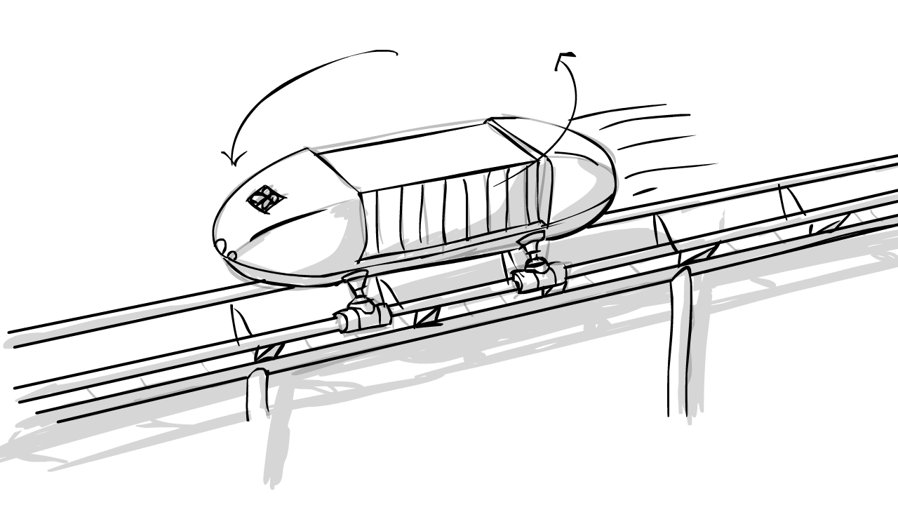
The camera cuts outside the passenger transport as it transition fades into a freight transport vehicle traveling along the track.

Slide 24
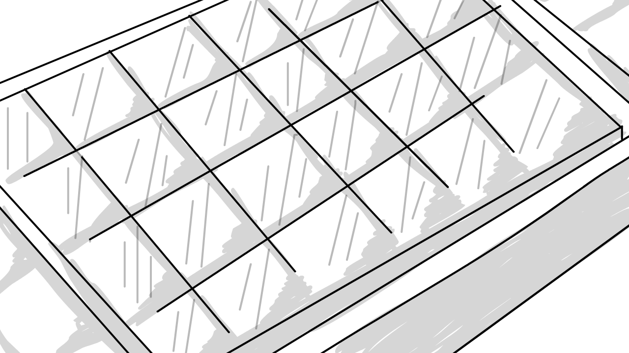
As it moves along, the camera zooms to focus on the track and its solar panels. A voice begins to put an emphasis on the solar panels.

Slide 25
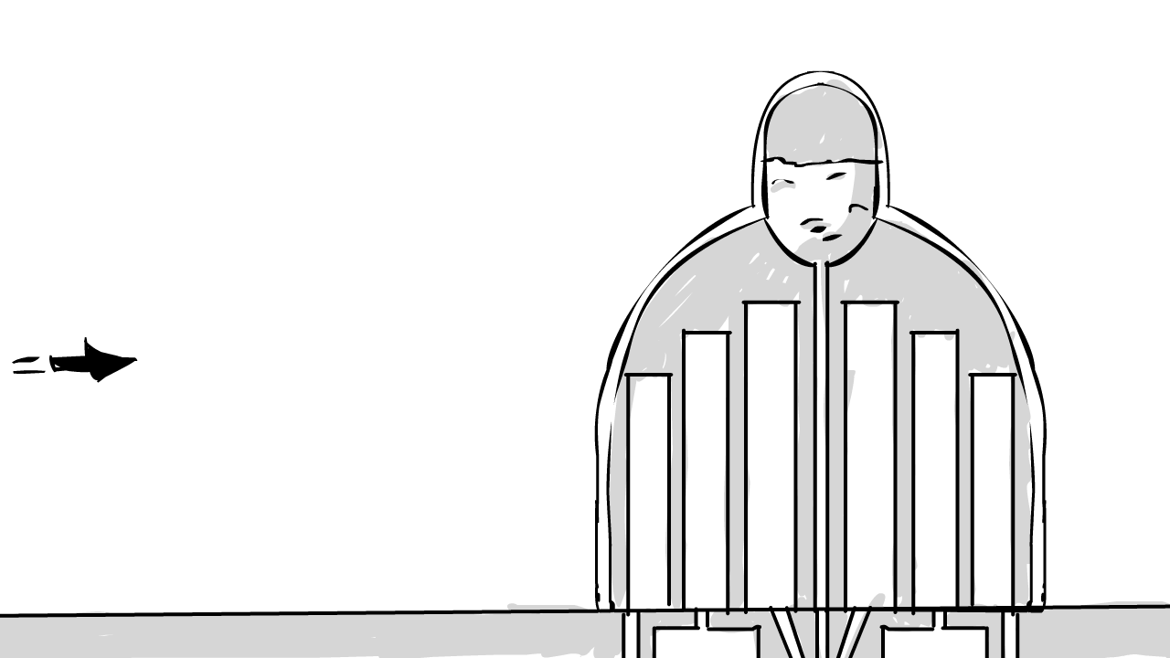
Along with the solar panels, the camera slides over to transition the movement of energy into the hydrogen stations. As this is being described, the camera is slowly moving around the station and is broken down. A voice describes the hydrogen system and how the Hyrail system will take away our dependency on foreign oil.

Slide 26
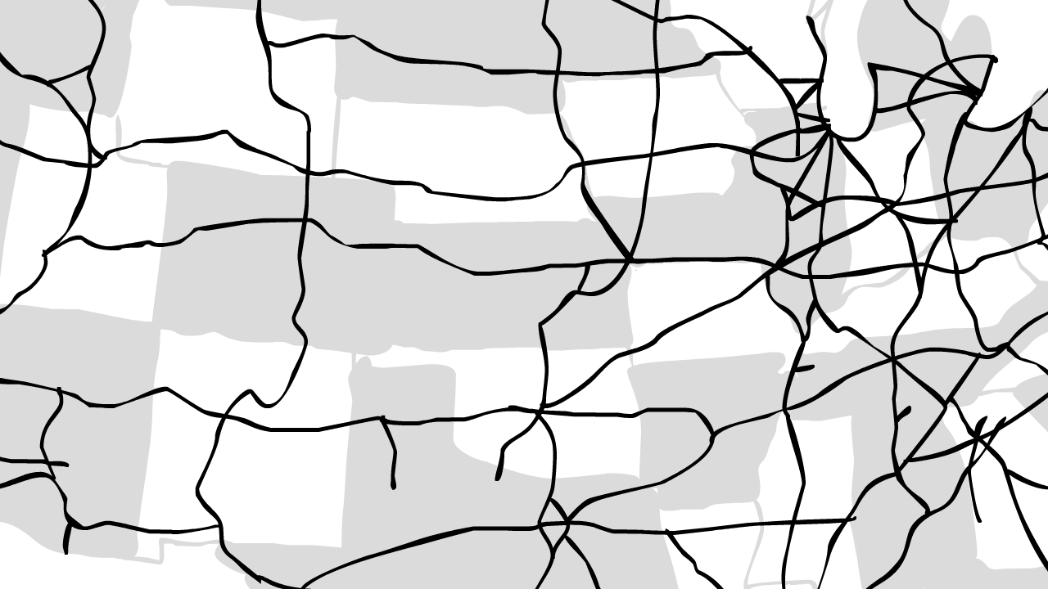
The camera slides over again to a view of the Hyrail grid system from above. As the grid system is being described, the camera is slowly moving around the system from above. A voice describes the grid system.

Slide 27
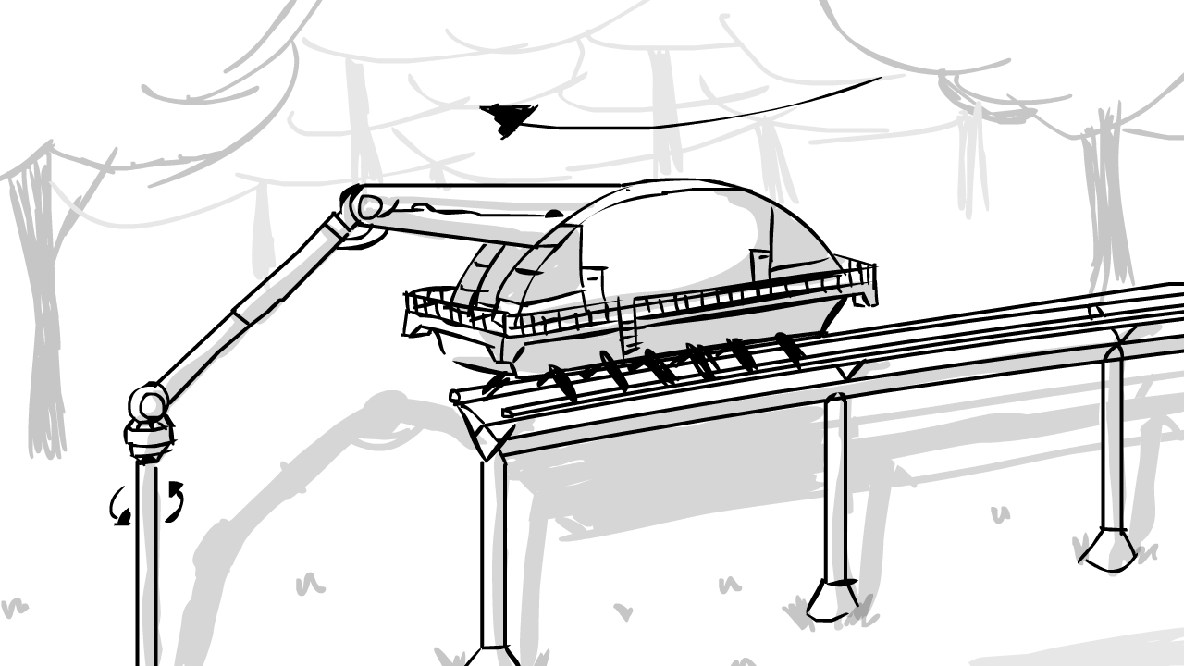
As we transition from a focus on the energy over to the environment, the camera slides over to show the construction vehicle from the back. As the camera travels up, we see the vehicle building the track in a summer setting. At times, the camera may zoom to focus on a key area. A voice describes the low impact of the Hyrail system.

Slide 28
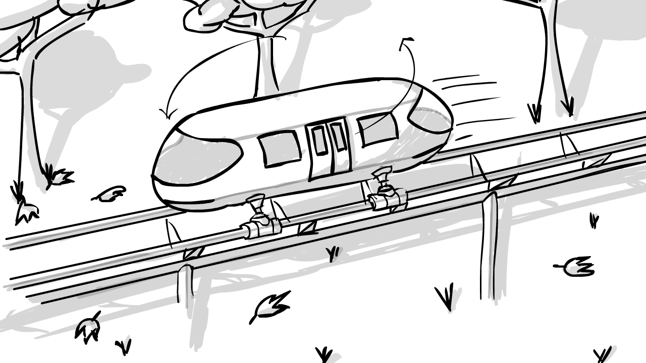
Slowly transitioning from summer into fall, the camera continues forward as the rails fade into finishing and a passenger transport catches up to the camera. As it reaches center point, the camera begins to run alongside it. At times, the camera may zoom to focus on a key area. A voice describes the plants and agriculture the Hyrail system will impact.

Slide 29
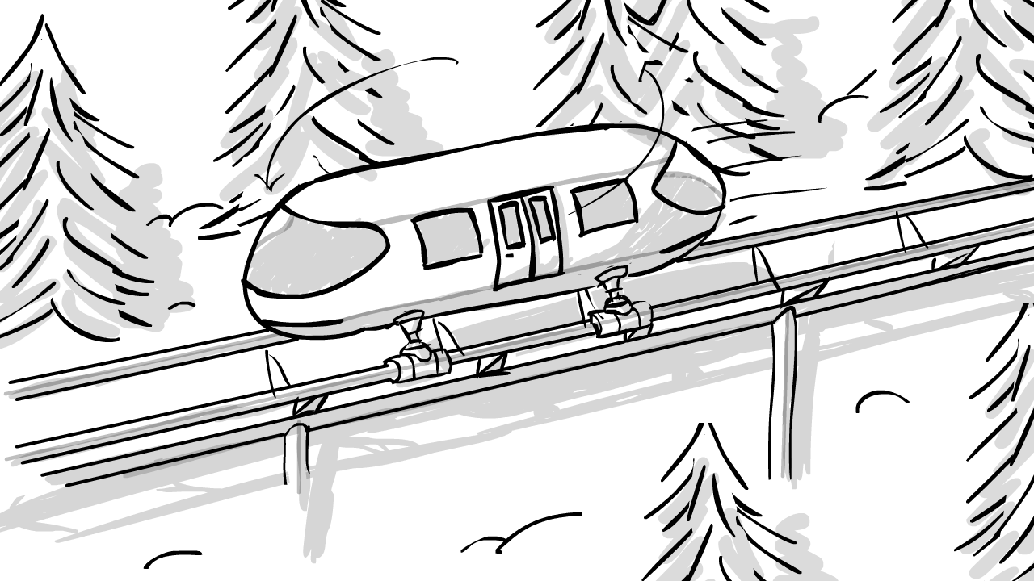
Slowly transitioning from fall into winter, the camera continues to follow the passenger transport now. At times, the camera may zoom to focus on a key area. A voice describes the clean burning of the Hyrail system.

Slide 30
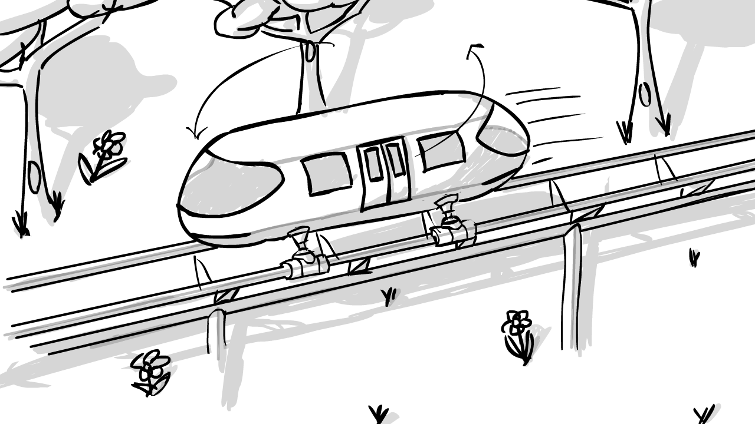
Slowly transitioning from winter into spring, the camera continues to follow the passenger transport. At times, the camera may zoom to focus on a key area. A voice describes the fresh water the Hyrail system creates and how it can help to water crops.

Slide 31
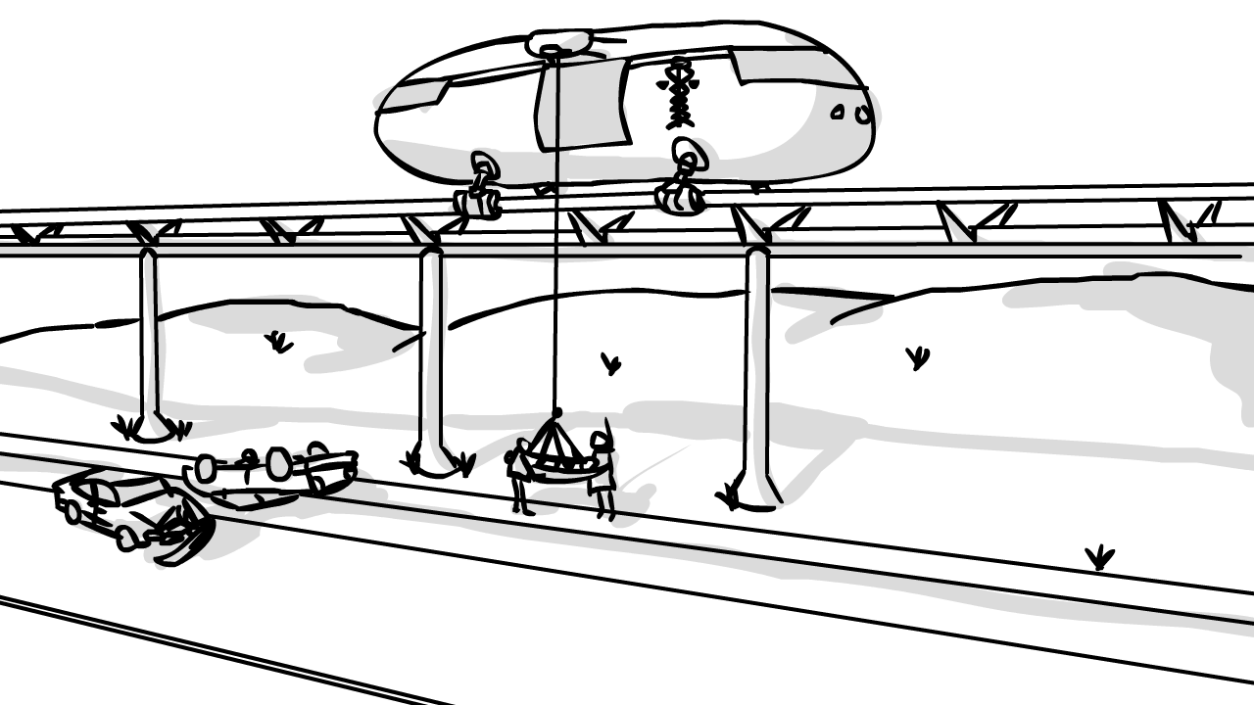
The scene transitions back to summer as it fades out. The topic moves from the environment and onto the national security. Here, the camera focuses on the medical transport as it travels along the rails, slowly moving around it. At times, the camera may zoom to focus on a key area. A voice describes how the Hyrail system will support evacuations in the case of emergencies.

Slide 32
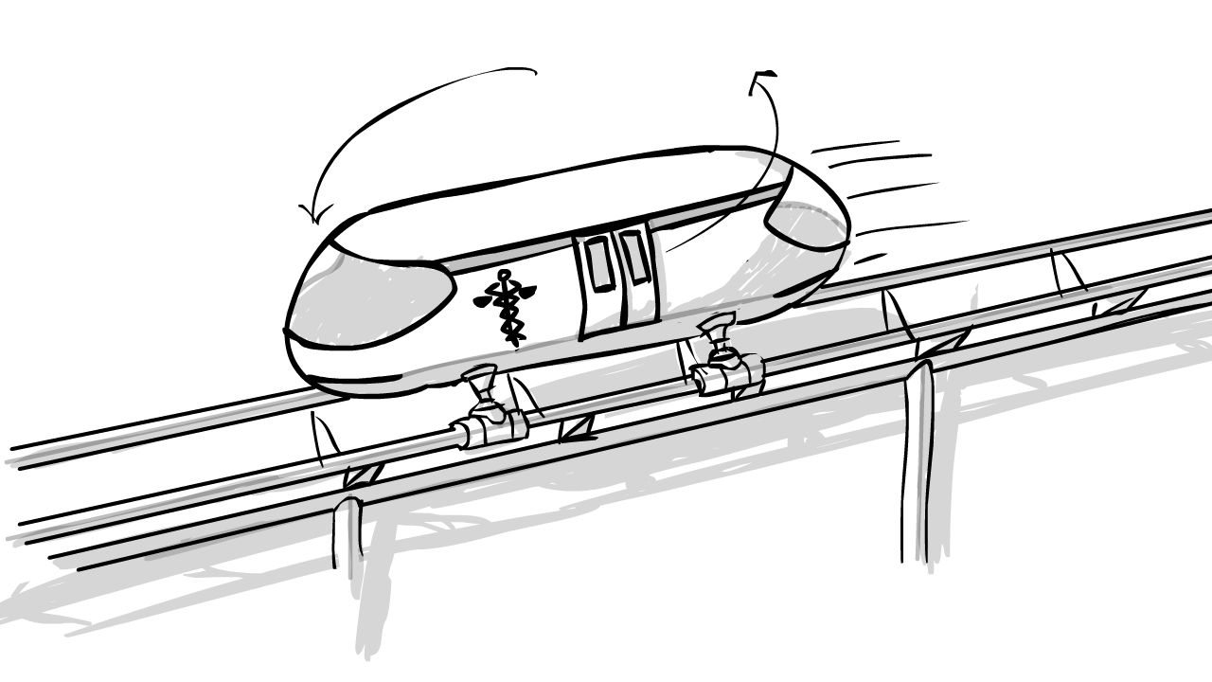
The camera slides to a different view of the medical vehicle and slowly moves around it. At times, the camera may zoom to focus on a key area. A voice describes how the Hyrail system can help power cities in the case of a blackout.

Slide 33
The camera slides to an above view of the grid system again. At times, the camera may zoom to focus on a key area. A voice describes the Hyrail system’s internet security.

Slide 34
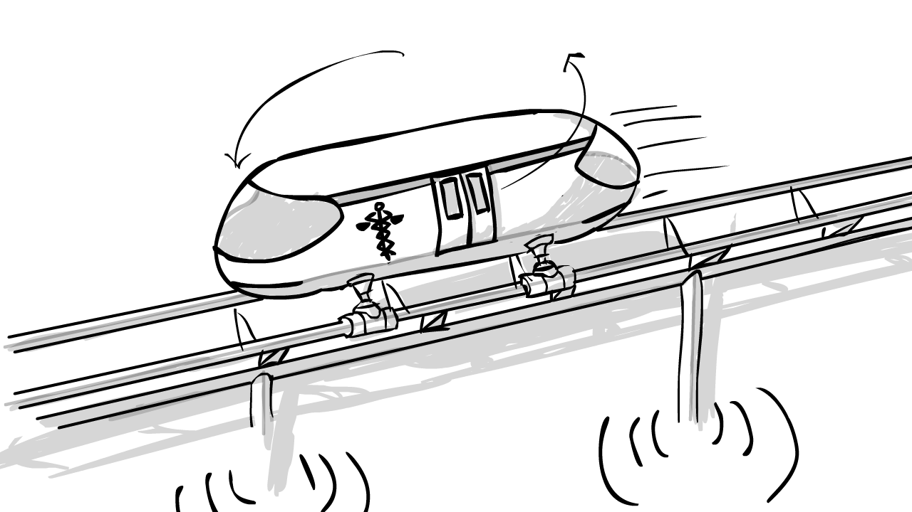
The camera slides to a view of the medical transport traveling along the rail and slowly moves around it. Signals appear around the rail. As the signals push out to the 3 mile radius, the camera zooms out. A voice describes the Hyrail system will provide wireless internet connection anywhere within 3 miles of the rails.

Slide 35
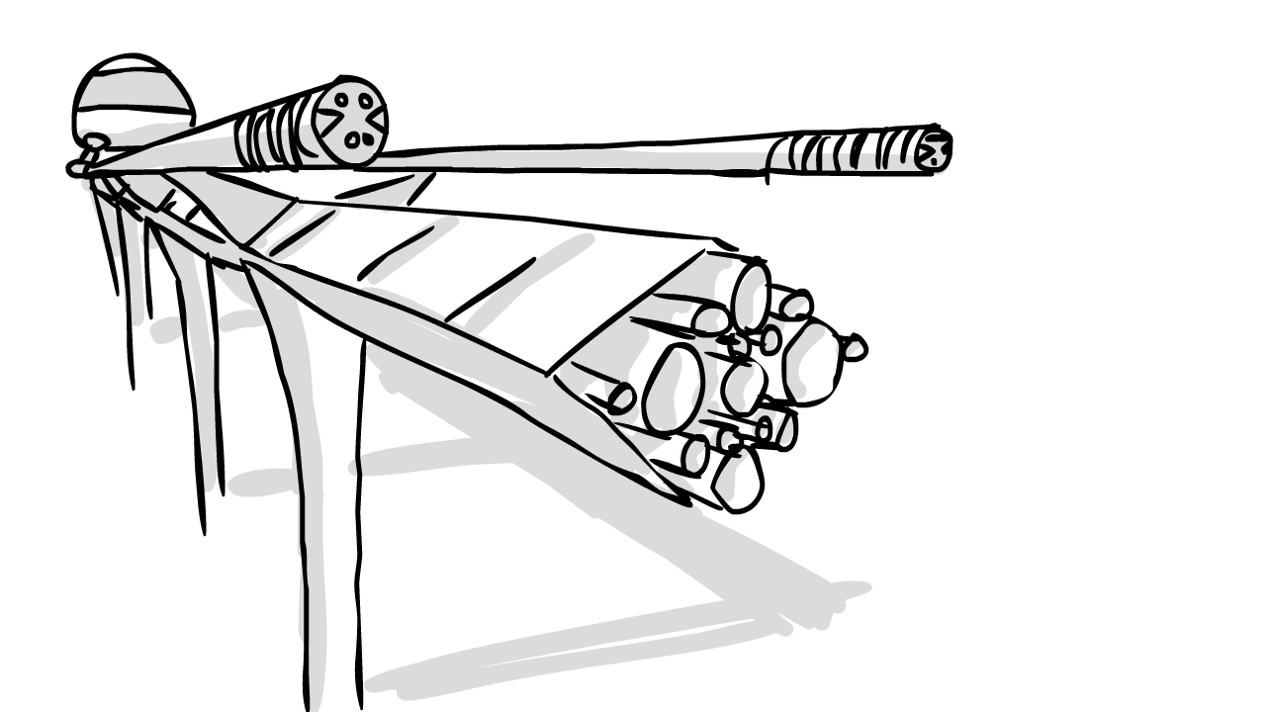
The camera slides to focus on the breakdown of the rails fiber optics, slowly shifting across the scene. A voice describes the fiber optics located within Hyrail system.

Slide 36
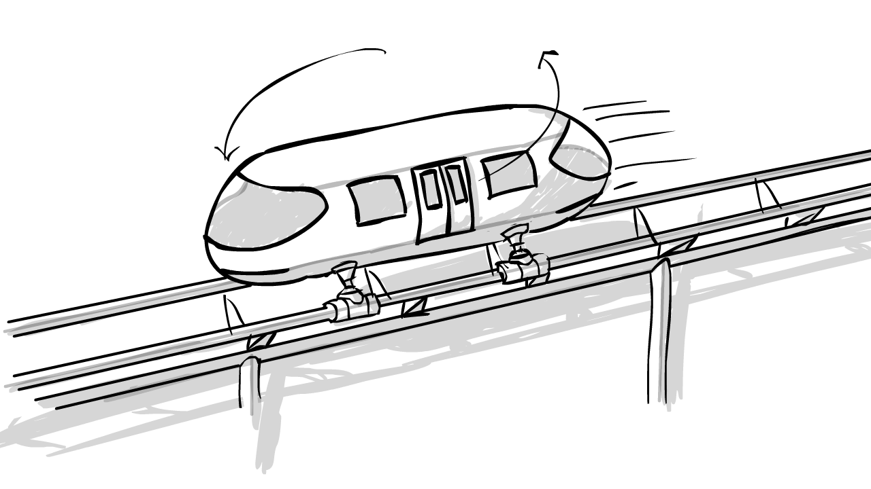
The camera slides to view the passenger transport, slowly moving around the transport as it moves along the track. The focus now shifts from national security to general safety. At times, the camera may zoom to focus on a key area. A voice describes the safety prevention of the Hyrail system.

Slide 37
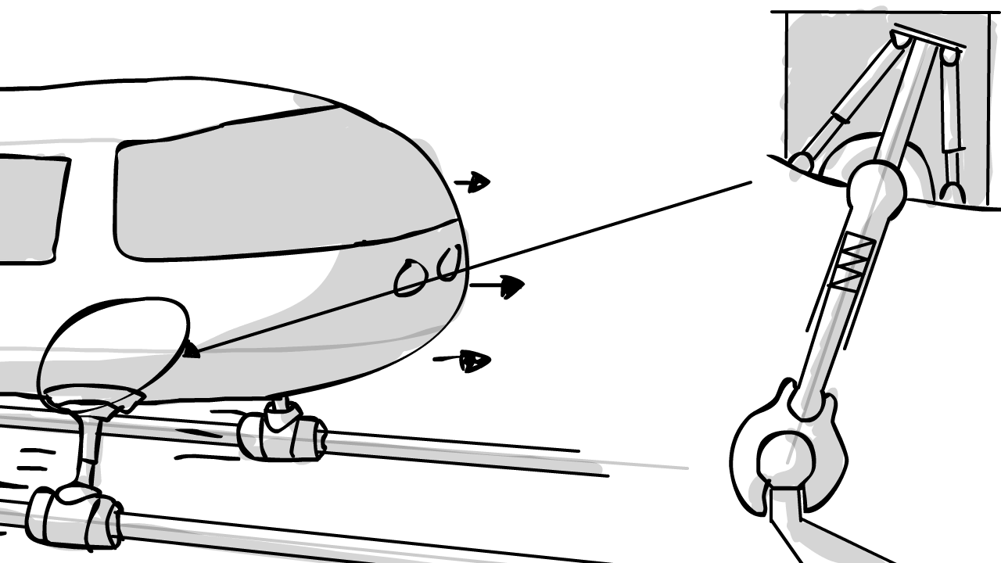
The camera slides to view the ball suspension, slowly moving around the area as it displays its effects on the transport as it moves along the tracks. At times, the camera may zoom to focus on a key area. A voice describes the ball suspension of the Hyrail system.

Slide 38
The camera slides to view the passenger transport. As it does, time appears to stop as the camera quickly moves ahead of the transport to a section of broken track….

Slide 39
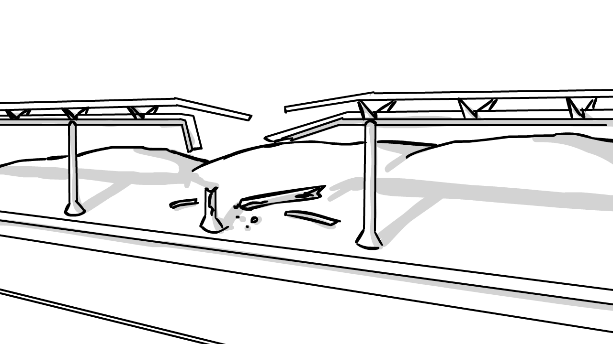
The camera slowly circles the broken track and ends by zooming back to the passenger transport coming to a stop. At times, the camera may zoom to focus on a key area. A voice describes the foreknowledge of the Hyrail system.

Slide 40
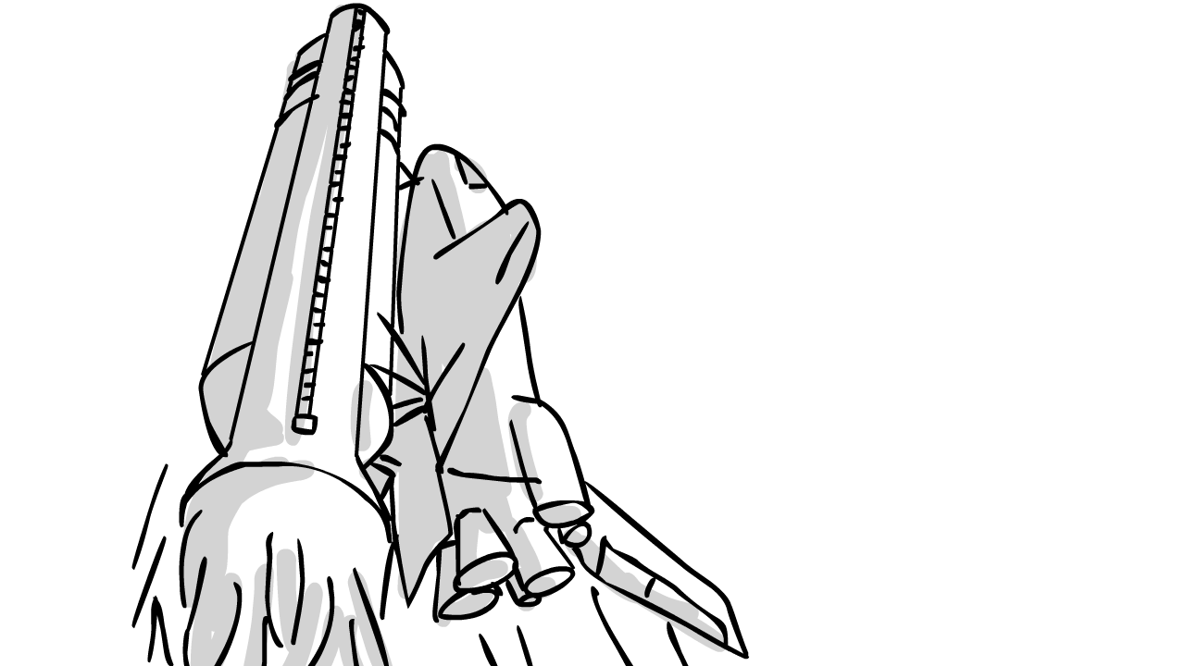
The camera slides to view a space shuttle taking off from the NASA base. As it takes off the topic sifts from safety to manufacturing. A voice describes the Hyrail system’s impact to help fuel NASA.

Slide 41
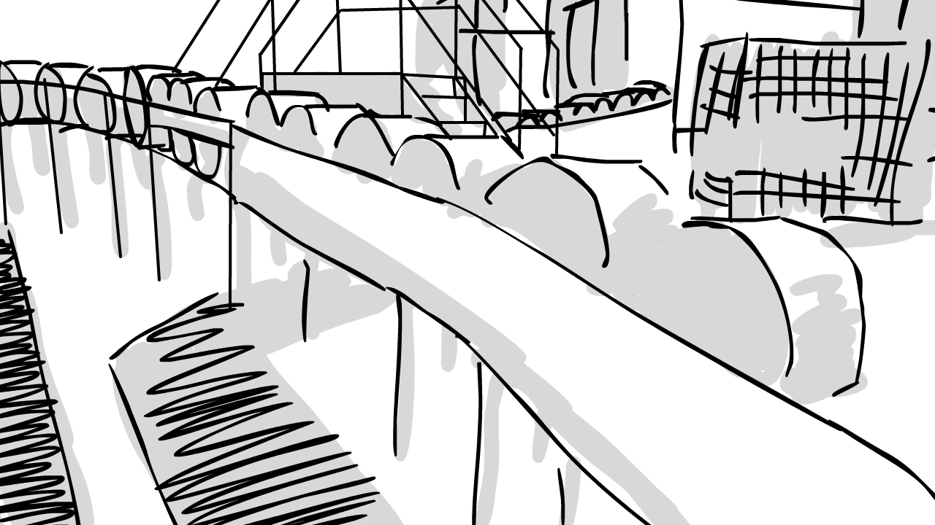
The camera slides to view a factory line. As it moves down to focus on several materials, it shifts to focus on a work. A voice describes the Hyrail system’s requirement for materials which will lead into adding jobs.

Slide 42
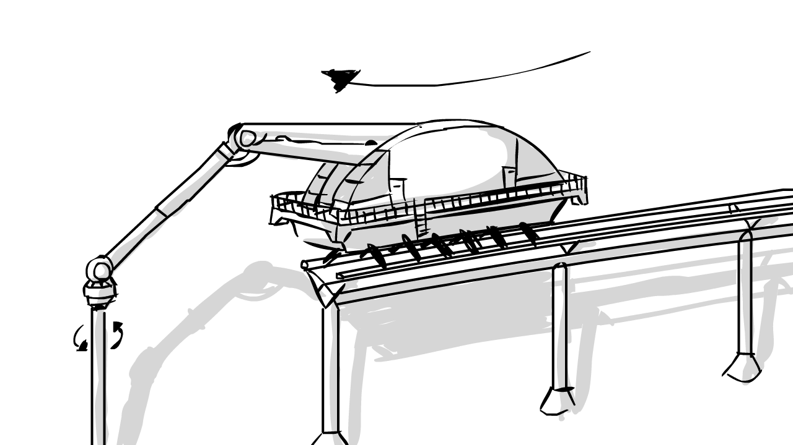
The camera slides to view the construction vehicle again. As it builds, the camera slowly moves around it. A voice describes the revenue that will be created by the Hyrail system and how it will come with no cost to the tax payer.

Slide 43
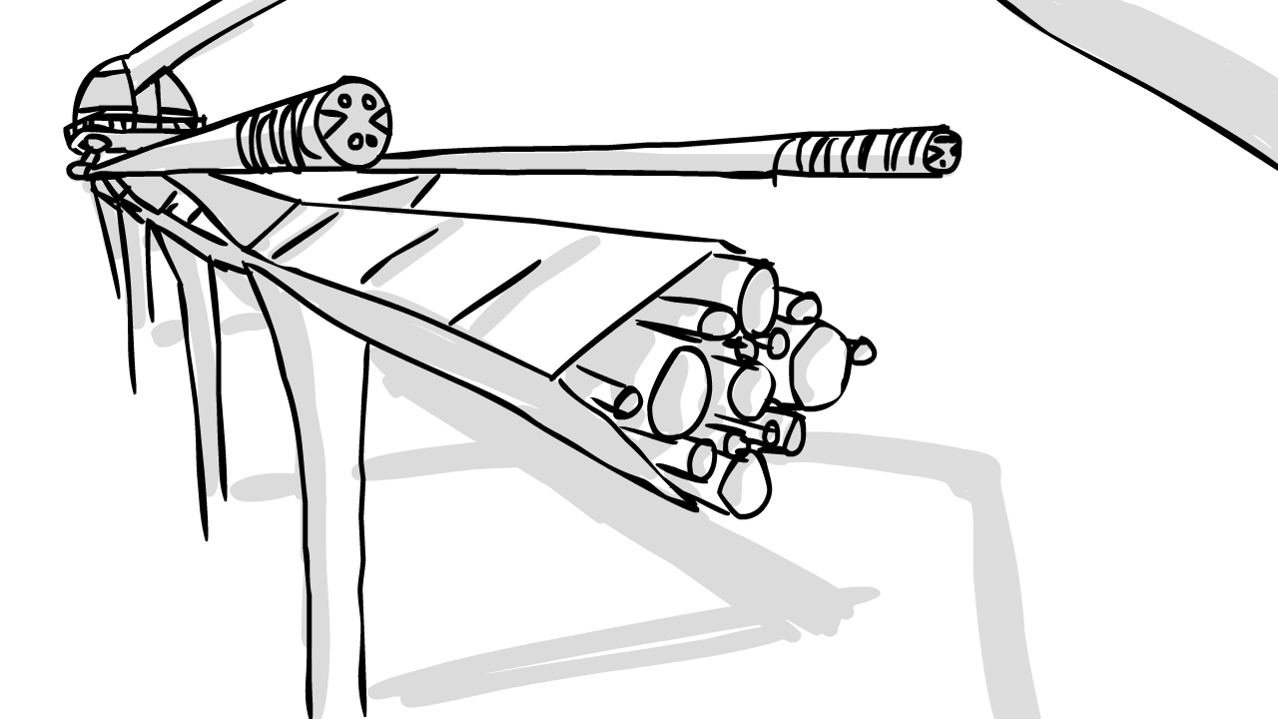
The camera slides to view the construction vehicle installing the track, focusing on the rails. The camera shifts slowly as the track is broken down. A voice describes the rail breakdown of the Hyrail system, recapping several parts such as the solar panels and fiber optics.

Slide 44
The camera fades to white. The tech-demo wraps and things move back around to the start to bring forth a close. The vibrant color tones return…

Slide 45
As camera fades from white, the vehicle transport comes back into view along with the Hyrail station. Everything is the same, only now you can tell they are in another location.

Slide 46
The camera cuts to show the vehicle exiting the vehicle transport.

Slide 47
The camera cuts again to a view of the back passenger side of the car where you see the child again.

Slide 48
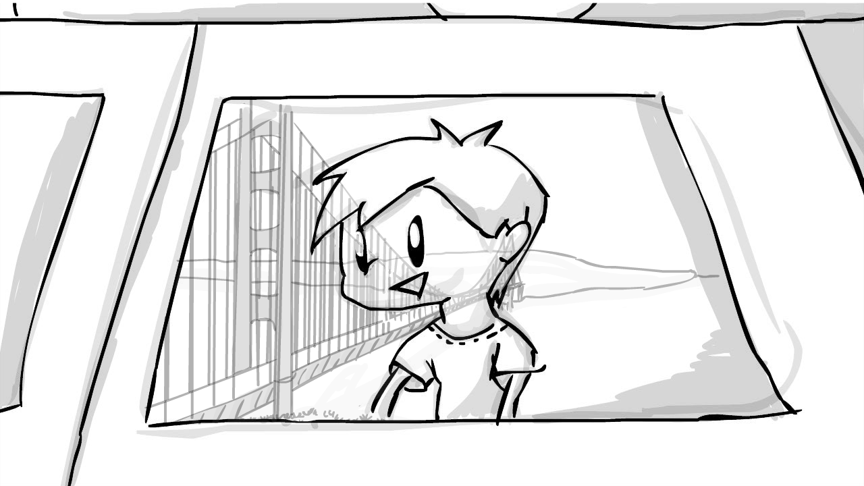
As the camera zooms, you see the reflection of the golden gate bridge in the window.

Slide 49
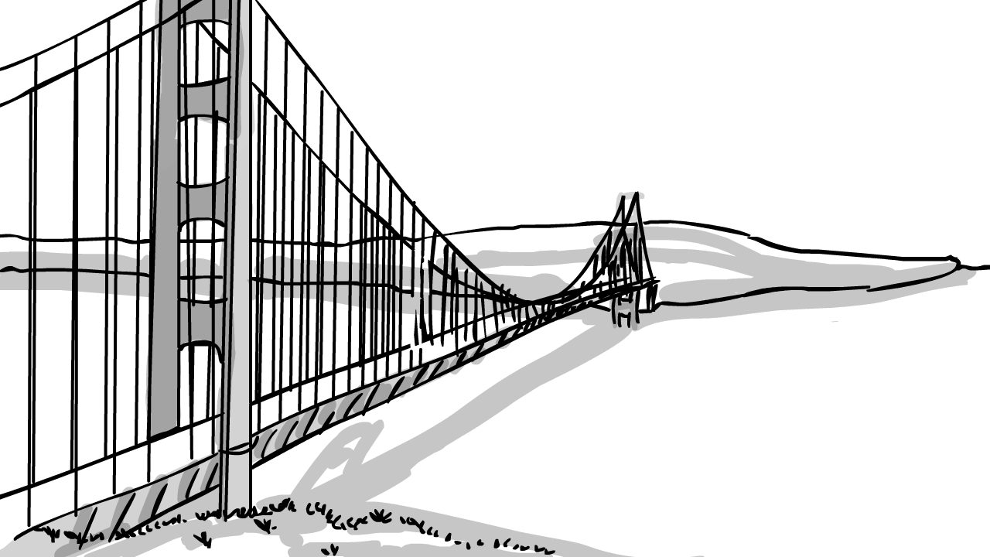
As the video comes to a close, the camera cuts to a shot from behind the vehicle as they cross the bridge, slowly rising and fading to white.

Slide 50
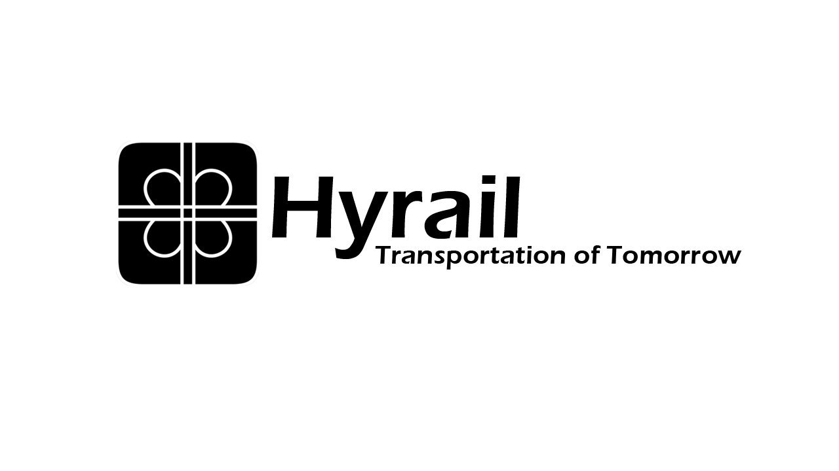
The logo fades in and a voice comes in to close the Hyrail with a single line. As the line is read, it also fades in.

